Slide 1
GENERATIVE AI + WEB APPLICATION
LegalEase
AI-powered legal document generation
Employment contracts · Lease agreements · NDAs
Project presentation

Slide 2
01 · THE PROBLEM
Traditional preparation repeats the same work
01
02
03
Structure
Draft
Format
Collect and organize parties, dates, and key terms.
Turn structured information into coherent legal language.
Prepare a readable document with consistent layout.
04
05
Edit
Export
Review wording, correct details, and repeat revisions.
Produce the final file in the format the user needs.
Manual effort is distributed across the entire path—not only the first draft.

Slide 3

02 · THE SOLUTION
LegalEase connects input, intelligence, and output
Users provide the document type and terms. LegalEase routes that information through a Streamlit interface, a FastAPI backend, and the Gemini API before returning an editable document.
ONE GUIDED PATH FROM PROMPT TO FILE
INPUT
ORCHESTRATION
Terms
Generation
Parties, dates, and key conditions.
Streamlit → FastAPI → Gemini AI/API.
OUTPUT
FORMATS
Document
TXT · DOCX · PDF
Preview, edit, and download.
Choose the file type that fits the next step.

Slide 4






03 · KEY BENEFITS
Practical benefits across the document journey
LegalEase focuses on a simpler creation experience—from first input to usable output.
Faster creation
Easy editing
Multiple types
Move from terms to a first draft with less repeated work.
Review and refine generated content before download.
Employment Contract, Lease Agreement, and NDA.
Multiple formats
Simple interface
AI-powered
Export as TXT, DOCX, or PDF.
A focused web application keeps the flow approachable.
Gemini AI/API supports the generation step.

Slide 5
04 · HOW LEGALEASE WORKS
Seven steps from terms to a downloadable document
01
02
03
Select
Identify
Define
Choose Employment Contract, Lease Agreement, or NDA.
Enter the parties involved in the document.
Add key terms and the effective date.
04
05
06
Generate
Preview
Edit
Send the structured request through the application.
Inspect the generated legal document.
Adjust the content where needed.
07
Download
Export the result as TXT, DOCX, or PDF.

Slide 6
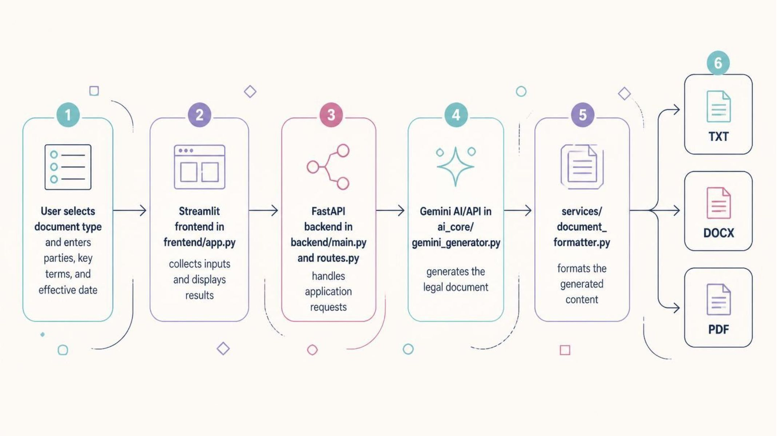
05 · SYSTEM ARCHITECTURE
Each layer has a focused responsibility
The architecture separates interaction, orchestration, generation, and document formatting.
Frontend
Streamlit interface
Backend
FastAPI routes
AI core
Gemini generator
Services
Document formatter

Slide 7




06 · KEY FEATURES
Implemented features, organized for a clear demo
Document inputs
AI generation
Document type, parties, key terms, and effective date selection.
Generate a legal document through the Gemini API.
Preview
Editable content
See the generated result inside the application.
Review and modify the generated text before export.
Three downloads
Failure handling
Provide TXT, DOCX, and PDF output options.
Handle temporary Gemini API failures within the application flow.

Slide 8
07 · TECHNOLOGY STACK
One Python-based stack, several focused tools
The project combines a web interface, API layer, AI service, document libraries, and development utilities.
LANGUAGE
FRONTEND
BACKEND
Python
Streamlit
FastAPI
Application language across the project.
Collect inputs and present results.
Expose the application request layer.
AI
EXPORT
PROJECT
Gemini API
python-docx · FPDF
dotenv · Pytest · VS Code
Generate the legal document content.
Produce DOCX and PDF files.
Configuration, testing, and development environment.

Slide 9
08 · APPLICATION WORKFLOW & OUTPUT
From the application screen to three usable files
APPLICATION FLOW
SCREENSHOT PLACEHOLDERS
01
Choose a type
Employment Contract, Lease Agreement, or NDA.
[SCREENSHOT PLACEHOLDER]
Input form
[SCREENSHOT PLACEHOLDER]
Generated preview
02
Enter terms
Parties, key terms, and effective date.
03
Generate and review
Preview the AI-generated document and edit it.
[SCREENSHOT PLACEHOLDER]
Download controls
04
Download
Select the required output format.
OUTPUT 01
OUTPUT 02
OUTPUT 03
TXT
DOCX
PDF
Plain-text document.
Editable Word document.
Portable document format.

Slide 10
09 · CONCLUSION
LegalEase turns a repeated task into a guided application flow.
The project demonstrates how Streamlit, FastAPI, Gemini AI/API, and document formatters can work together to create, review, edit, and export legal documents.
More templates
Authentication
Document history
Cloud storage
Advanced formatting
AI-assisted editing
Future enhancements for the next version

